Slide 2
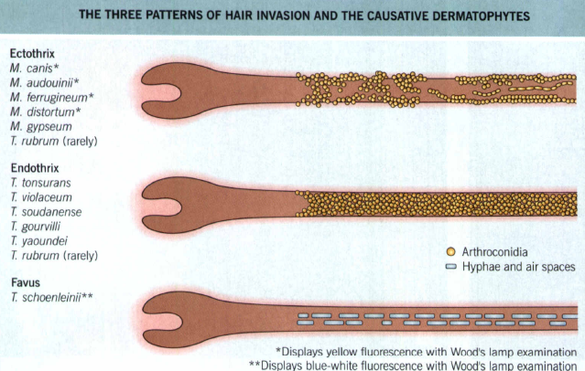
Tinea Captis
Is a dermatophytosis of the scalp and associated hair.
It may be caused by any pathogenic dermatophyte from the genera Trichophyton and Microsporum except T. concentircum
The most common cause worldwide is M.canis
Ectothrix dermatophytes typically establish infection in the perifoilicular stratum corneum
Endothrixi infections is the same except that the pathogen remain within the hair shaft, replacing the intrapilary keratin and leaving the cortex intact.
Affects toddlers and school age children, sometimes as epidemics. Rare after 16 years.
Transmission occurs from person to person, animal to person, or via fomites
Poverty, debilitating chronic illness and malnutrition are risk factors

Slide 3
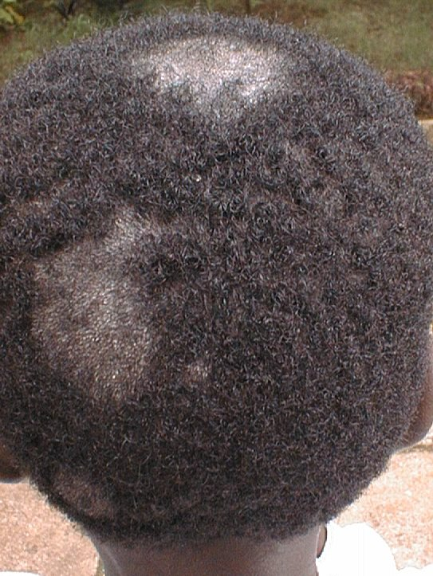
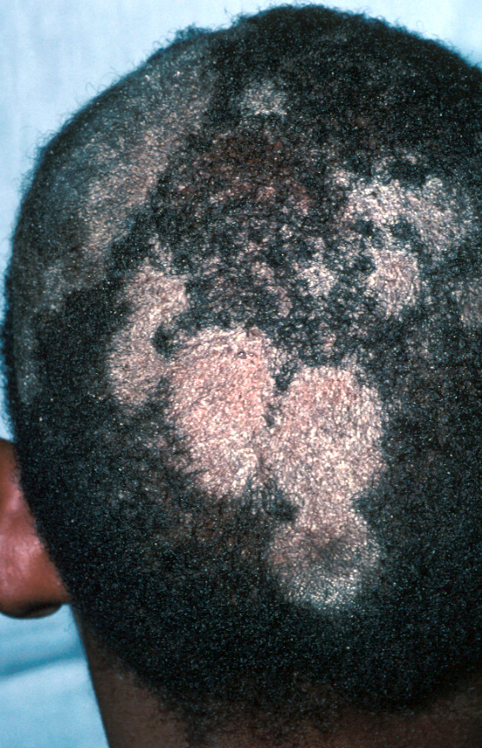
It could be inflammatory or non inflammatory based on species involved.
C/F-
1. Grey Patch:
  patches of scalp alopecia with scale. Small patches coalesce, forming larger patches. Inflammatory response minimal but massive scaling.

Slide 4
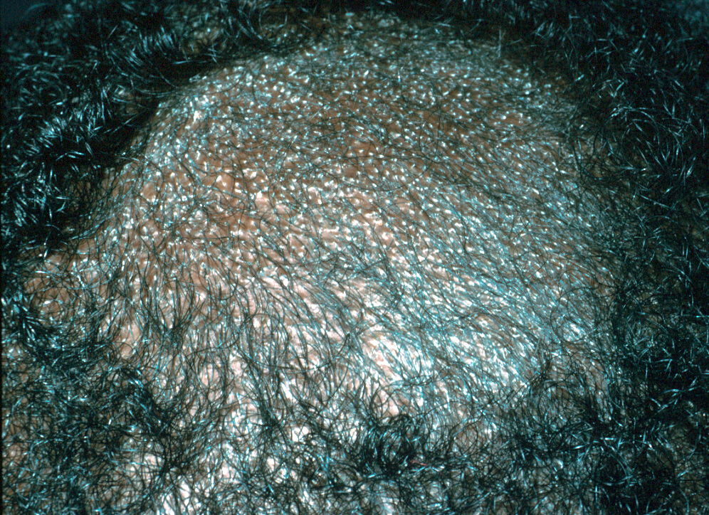
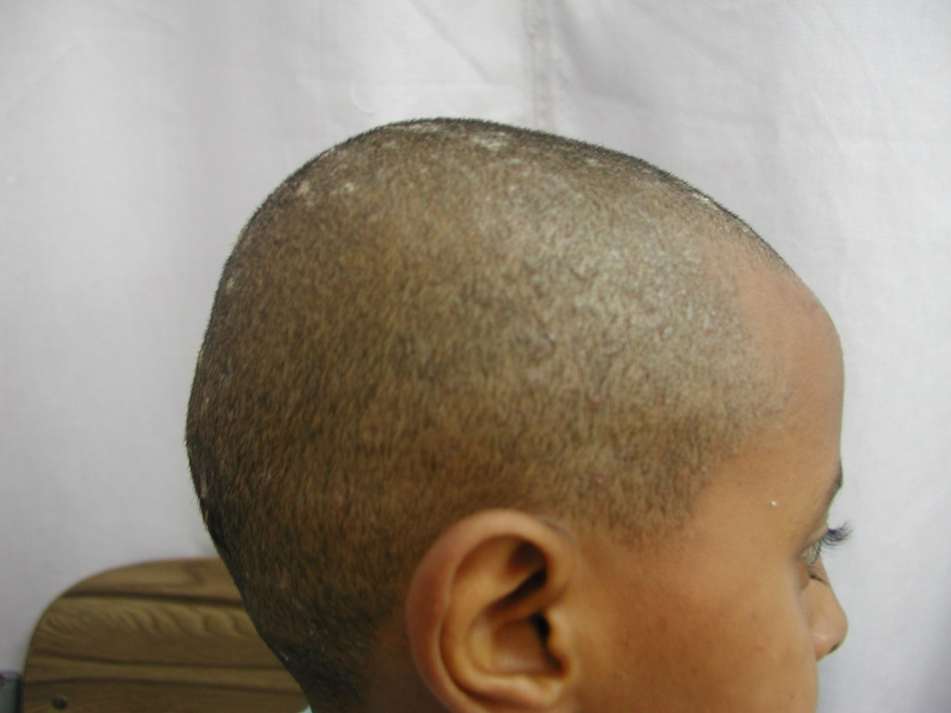
2. Black Dot:
  Broken-off hairs near surface give appearance of “dots”. Tends to be diffuse and poorly circumscribed. Resembles seborrheic dermatitis

Slide 5
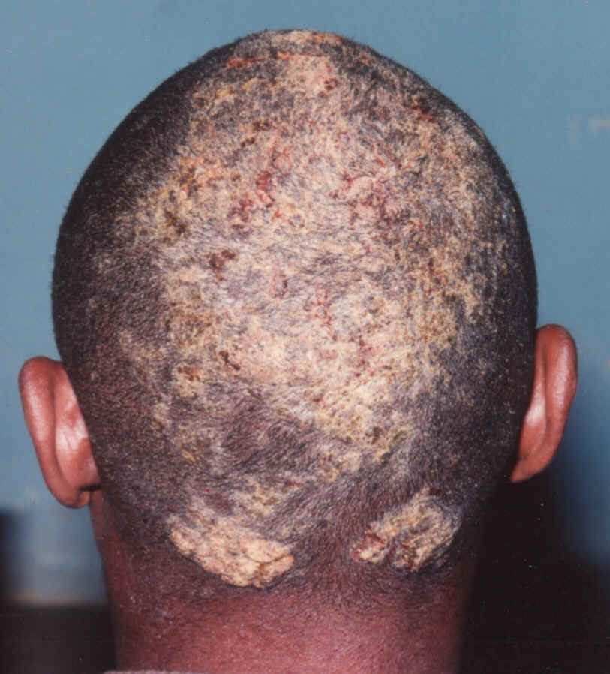
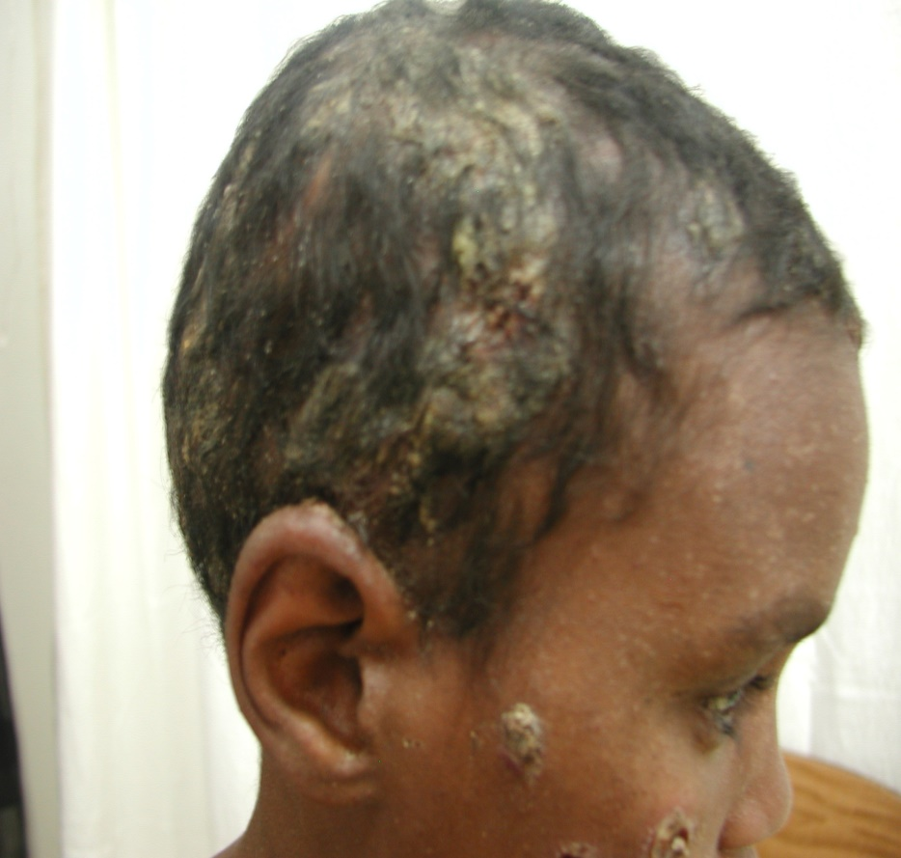
3. Kerion:
  Characterized by boggy, purulent, inflamed nodules and plaques extremely painful; drains pus from multiple openings, like honeycomb

Slide 6
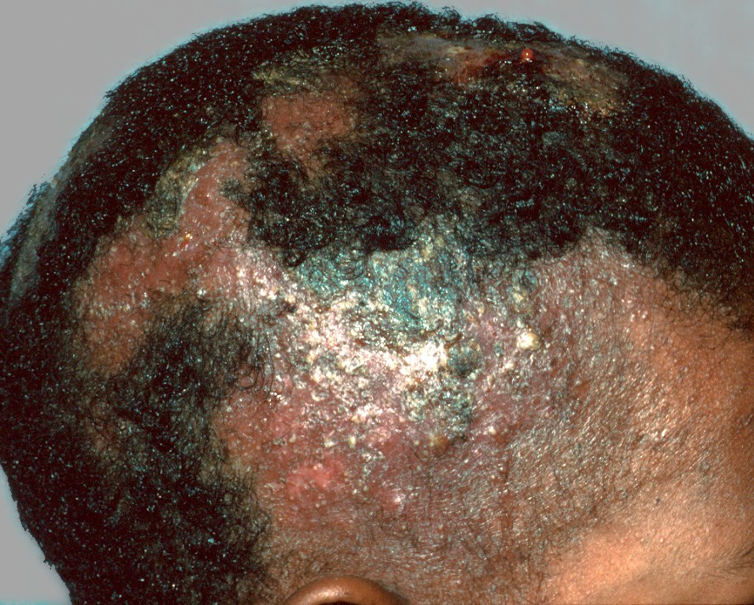
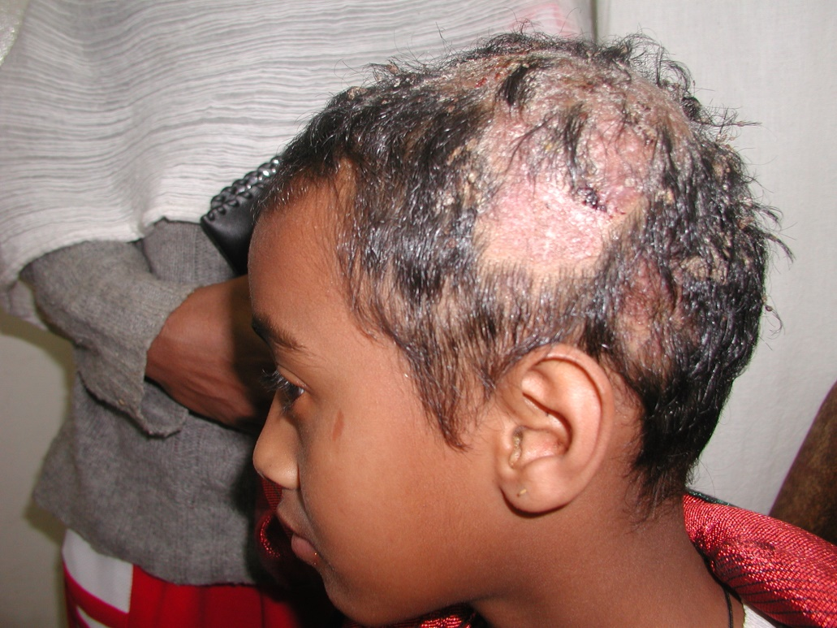
Favus:
  Thick yellow adherent crusts (scutula) composed of skin debris and hyphae that are pierced by remaining hair shafts. Fetid odor.

Slide 7
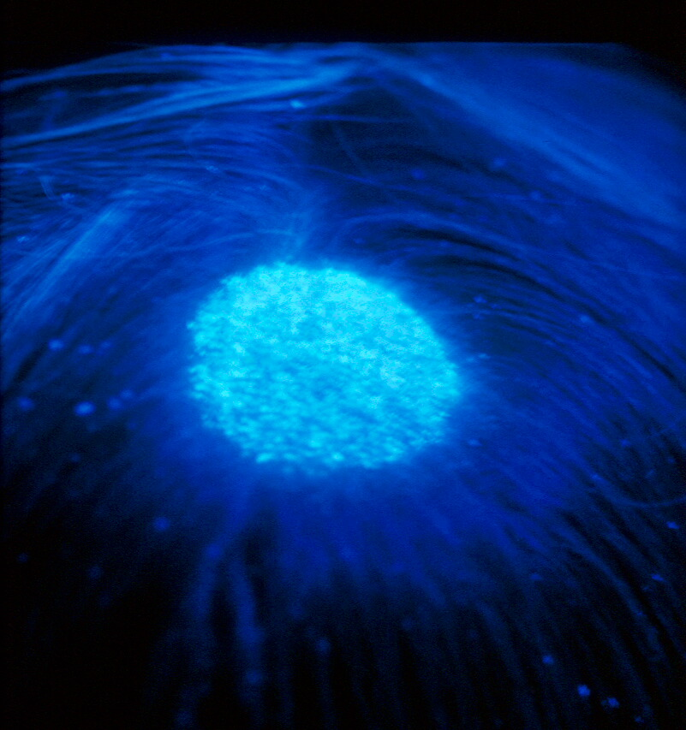
Ixn-
Woods Lamp examination:
- green yellow fluorescence for lesions caused by Microsporum spp,
- T. Schoenleini give dull green fluorescence
KOH microscopy
Sabaroud’s Agar Culture: up to 4 weeks at 26º C.
Mgt
griseofulvin - Pediatric Dose: 10-15(20-25) mg microsize/kg/d PO or 7.3 mg ultramicrosize/kg/d for 6-8 wk.Better absorption with fatty food.
Topical agents are ineffective.
All contacts and family members should be examined and treated.
Chronic untreated kerion and favus, can result in permanent scarring alopecia
Steroids may help in inflammatory types (1mg/kg for 10-15 days)
Selenium sulphide shampoo may help in decrease the risk of spreading infection.
Regrowth of hair is the rule if treated with systemic antifungal agents

Slide 8
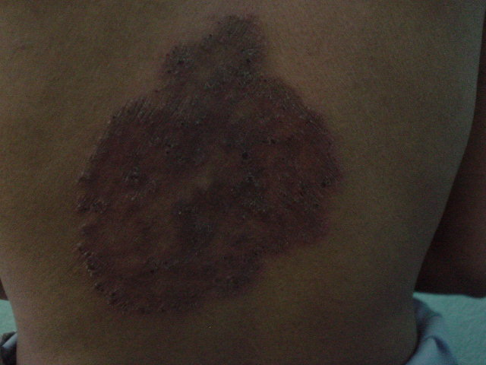
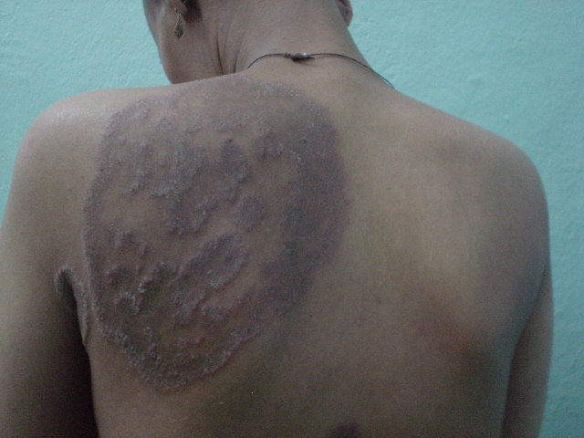
Tinea Corporis
Dermatophyte infections of the trunk, legs, and arms, ex-cluding the feet, hands, and groin.
Occurs in all ages as single (occasionally multiple) circular arcuate lesions with active raised margin and a tendency to clear centrally.
Mostly asymptomatic
Granulomatous reactions (Majocchi’s Granuloma) and bullae formation with pruritis may occur.

Slide 9
Mgt
White field’s ointment, topical azoles(1% Clotrimazole, 2%Ketoconazole) treats localized cases effectively.
Should be given continuously till the lesion clears completely, at least three weeks.
Systemic antifungals for extensive cases.

Slide 10
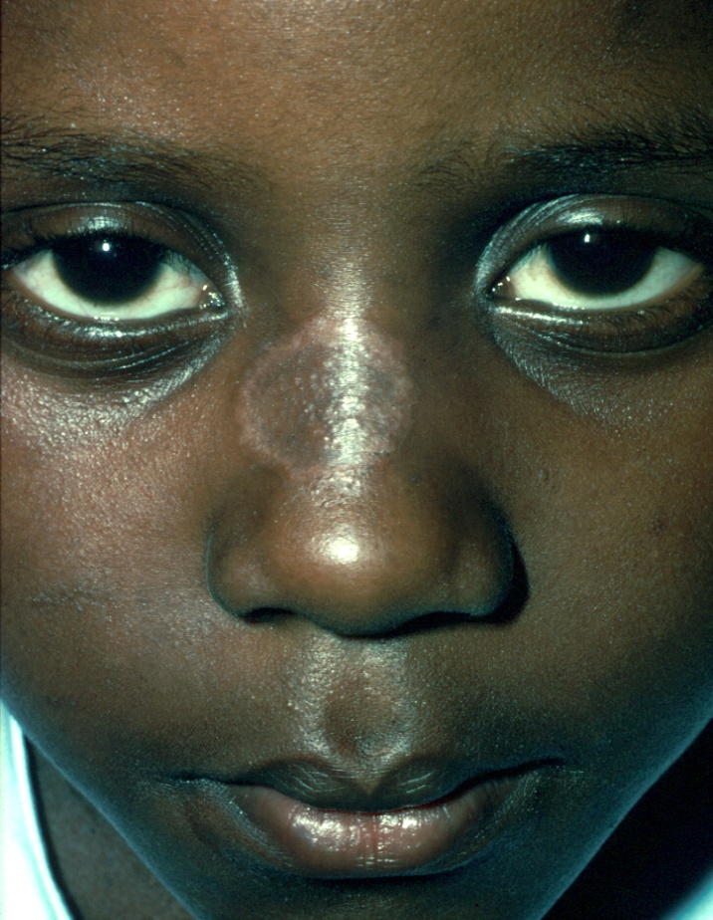
Tinea Facials
seen on the nonbearded parts of the face
The lesions are usually pruritic, itching and burning may become worse after exposure to sunlight.
Some lesions may resemble those of tinea corporis; others may have little or no scaling or raised edges.
Well-circumscribed erythematous patch
Direct infection or secondary spread from preexisting infection site
Commonly seen in children
Etiologies
T. mentagrophytes var. mentagrophyte and T. rubrum
M.cannis and M.audouinii
Diagnosis & Treatment
As tinea corporis

Slide 11
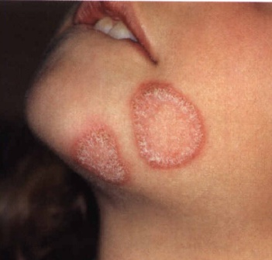
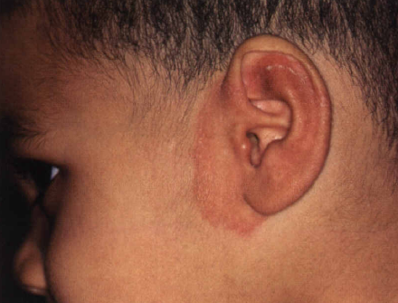
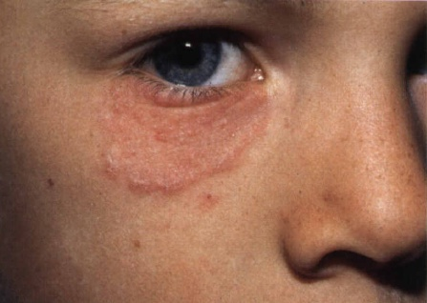

Slide 12
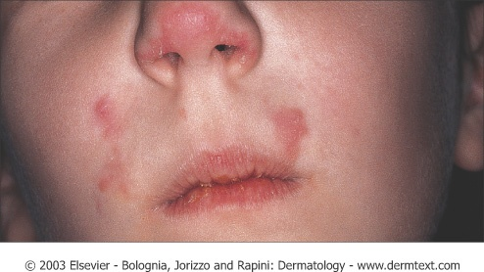
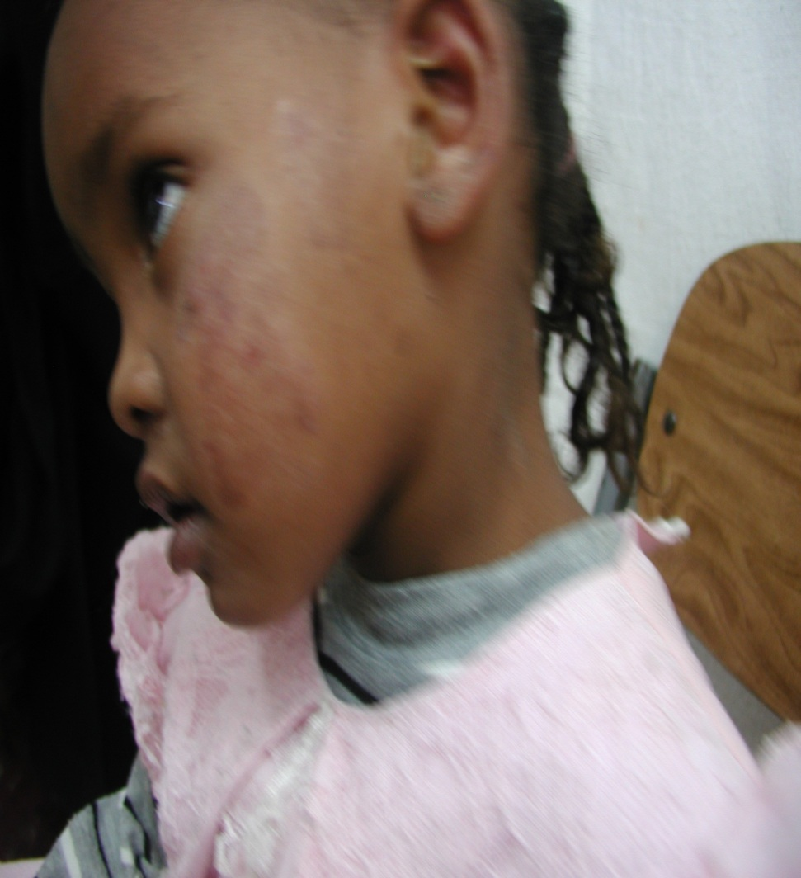

Slide 13
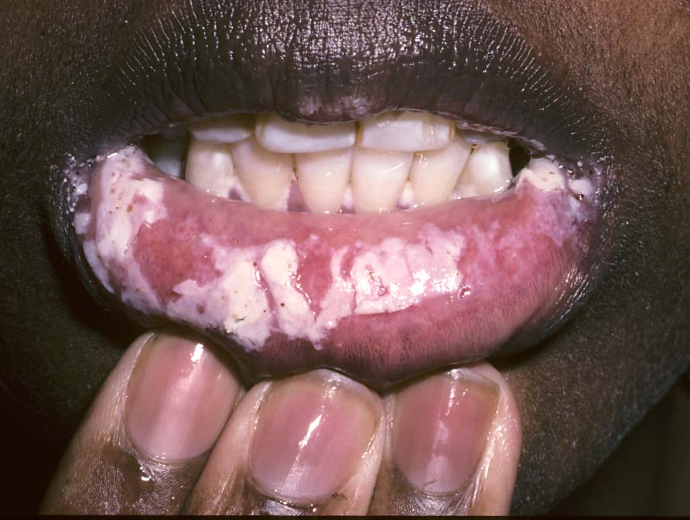
Oral Trush
Classification of Candidiasis
SUPERFICIAL MUCOSAL CANDIDIASIS
  Vaginal and Vulvovaginal Candidiasis
  Oropharyngeal Candidiasis
    Erythematous (atrophic) candidiasis
    Pseudomembranous candidiasis (thrush)
    Candidal leukoplakia (hyperplastic candidiasis)
    Angular cheilosis
DEEP MUCOSAL CANDIDIASIS

Slide 14
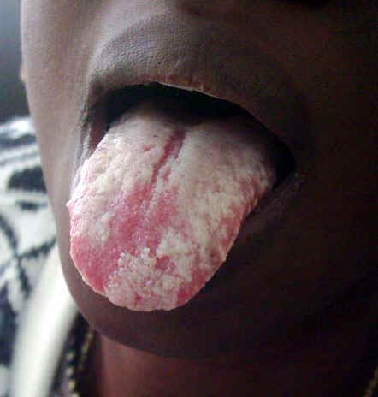

Slide 15
Mgt
Systemic or topical azoles.
Nystatin BID is very effective for orophryngeal candidiasis
Chronic supressive doses are needed for recurrent cases

Slide 16
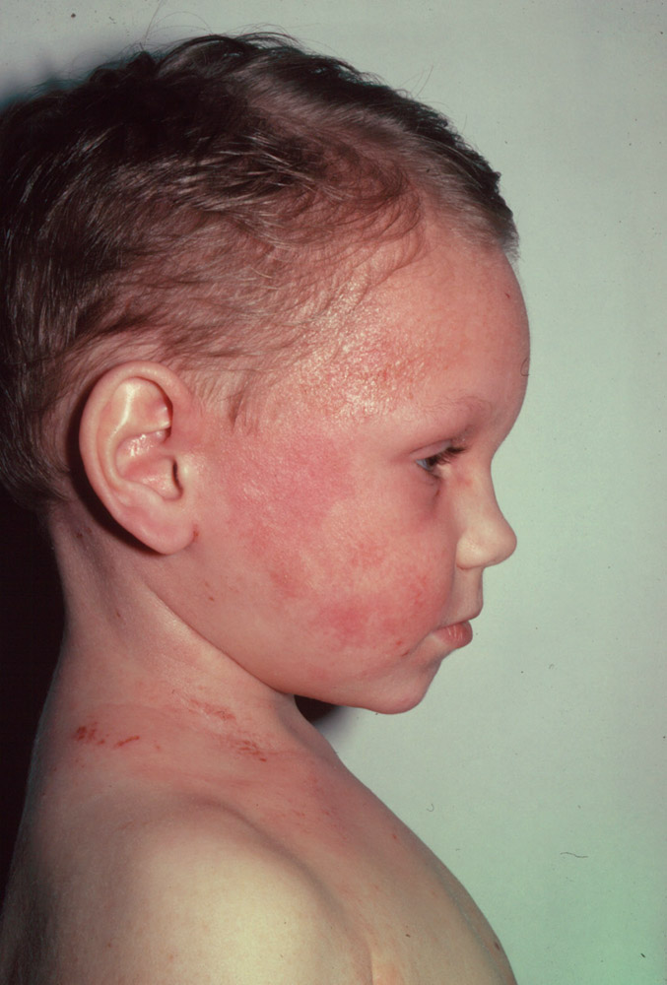
Atopic Dermatitis
Primary Defect is synthesis of IgE rather than IgG, it is a T cell - mediated hypersensitivity
The most common chronic relapsing
skin disease in infancy and childhood
Affects 10-30% of children
Atopic March, sometime called
Allergic March, refers to the natural history or typical progression of allergic diseases that often begin early in life. These include atopic dermatitis (eczema), food allergy, allergic rhinitis (hay fever) and asthma.

Slide 17
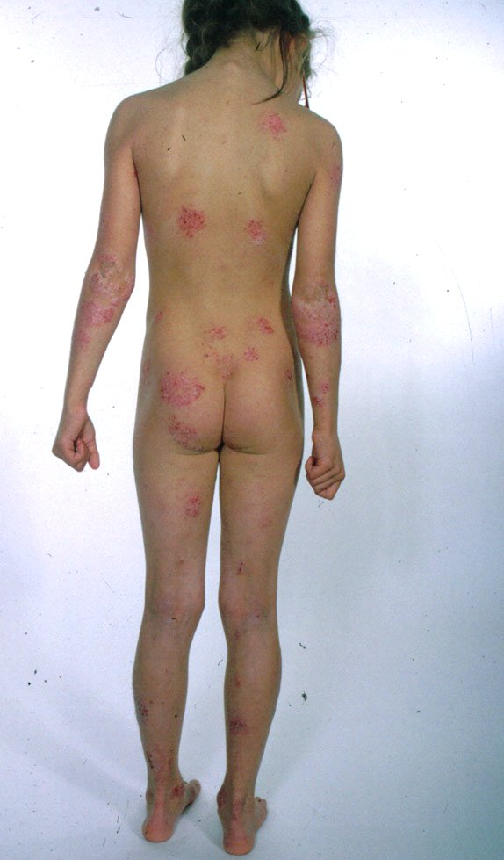
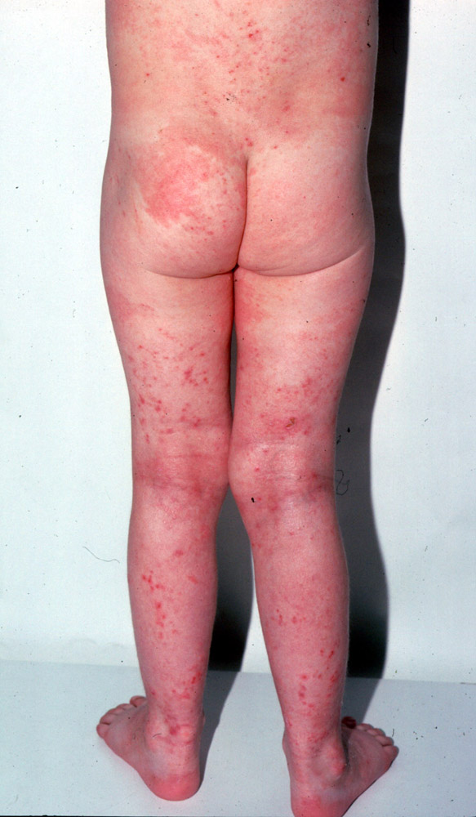

Slide 18
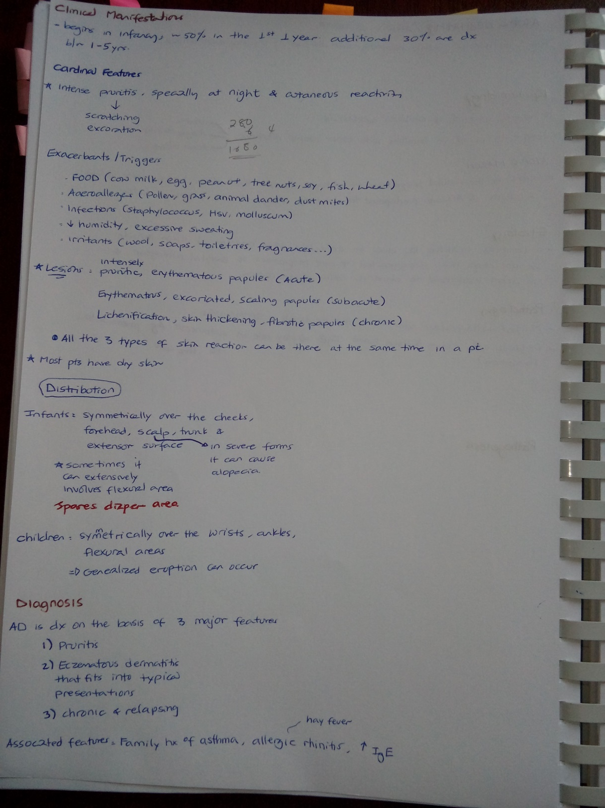

Slide 19
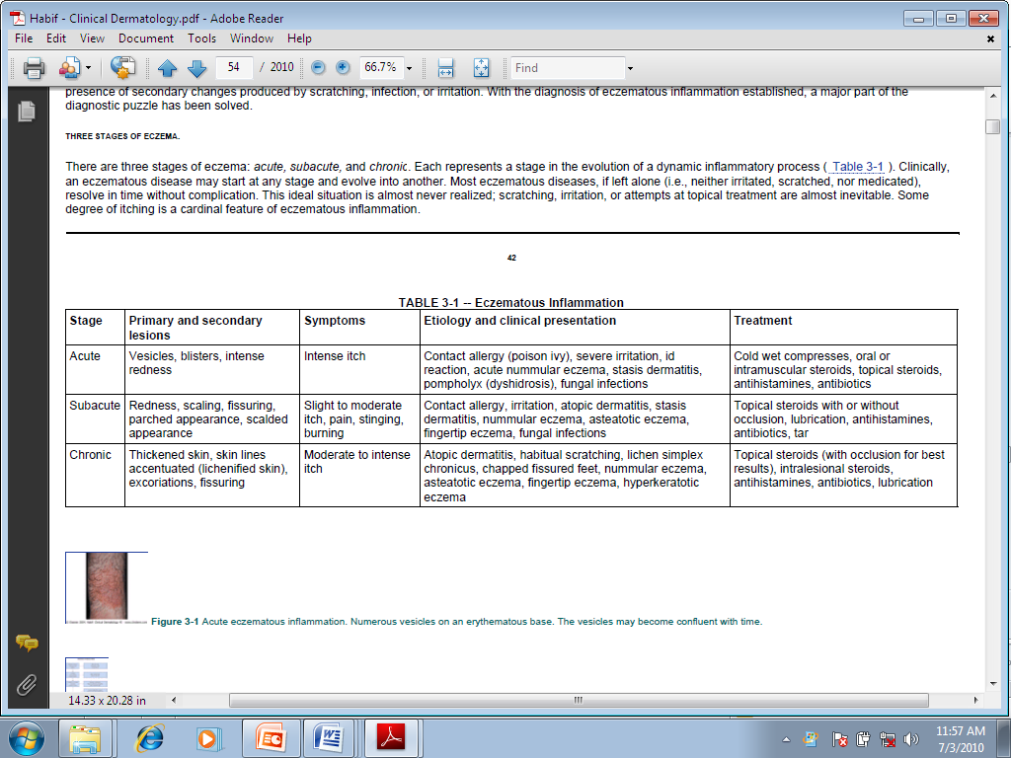

Slide 20
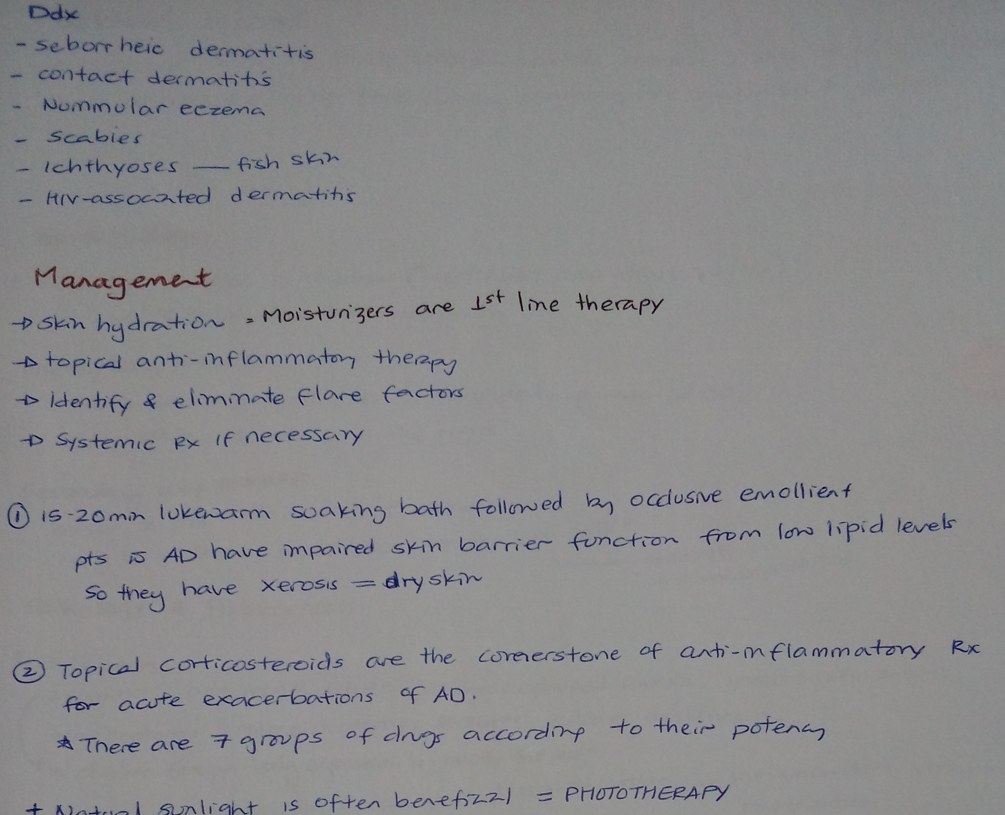

Slide 21
Ddx: Seborrhoeic eczema
  Infantile
  Adult
Complications
Infection:
  Bacterial:
    Staphylococci
  Viral:
    Herpes viruses
    molluscum contagiosum
    Fungi – pityrosporum orbiculare

Slide 22
Seborrheic Dermatitis(SD)
A very common chronic, relapsing, and usually mild form of dermatitis that occurs in infants and in adults.
The severity may vary from minimal, asymptomatic scaliness of the scalp (dandruff) to more widespread involvement
SD has a biphasic incidence, occurring in infants between the ages of 2 weeks and 12 months, and later, during adolescence and adulthood.
Predisposing and Exacerbating Factors
Genetic
Immunosupression - HIV infection
Parkinson disease
Emotional stress
Etiology : Fungus of genus Malassezia

Slide 23
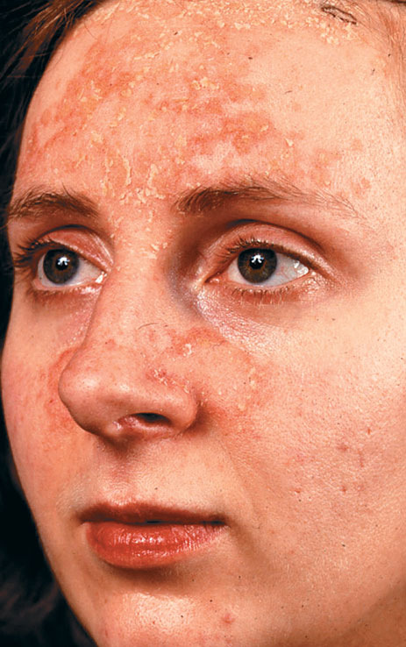
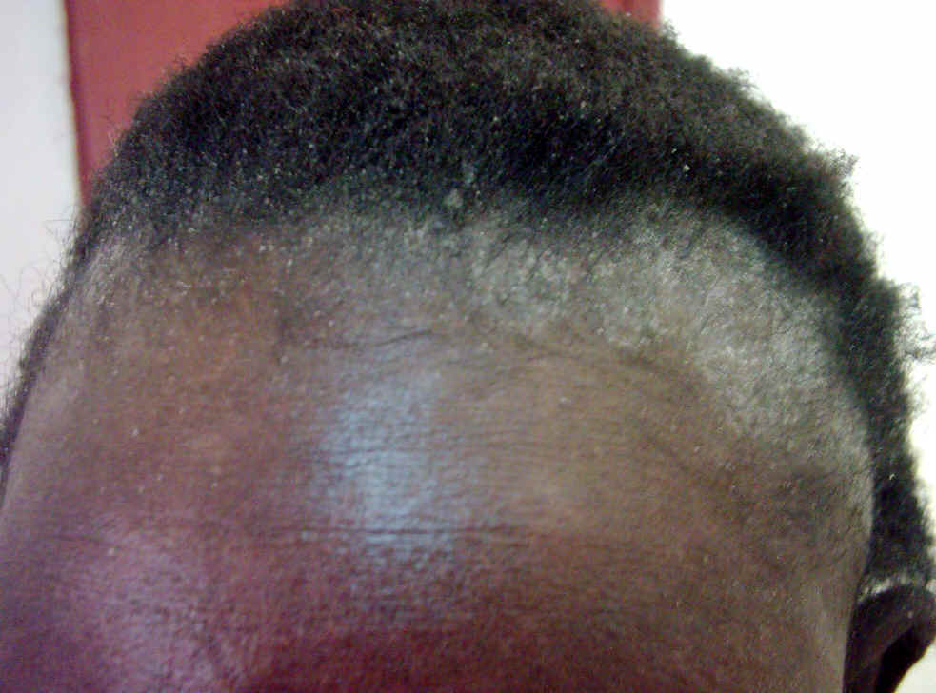
C/F- usually characterized by well demarcated erythematous plaques with greasy-looking, yellowish scales distributed on areas rich in sebaceous glands.
The mildest and most common form of scalp seborrheic dermatitis is dandruff
Dandruff may be asymptomatic or accompanied by mild pruritus

Slide 24
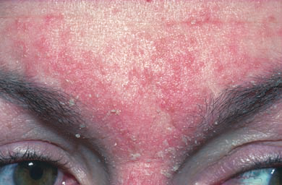
Periocular — Blepharitis with redness of the free margin of the eyelids and yellow crusting between the eyelashes may be the sole manifestation of seborrheic dermatitis.
Face — Facial lesions favor the forehead below the hairline, the eyebrows and glabella, and the nasolabial folds. They may extend to the cheeks and malar areas in a butterfly distribution.

Slide 25
Dx - usually made clinically based on the appearance and location of the lesions.
Ddx - Psoriasis –in adolescents
Atopic dermatitis, SLE Malar rash, Rosacea, Tinea corporis/fasialis
Rx - Initial Topical Therapy
Scalp- Effective over-the-counter (OTC) shampoos containing selenium sulfide, zinc
pyrithione, are helpful.
Tar shampoos (OTC) are equally effective in many patients. Low-potency glucocorticoid solution, lotion, or gels following a medicated shampoo (ketoconazole or tar) for more severe cases.
Face and Trunk-
Ketoconazole shampoo ,
2% Glucocorticoid cream and lotions:
Initially 1 or 2.5% hydrocortisone cream, 2% ketoconazole cream,
1% pimecrolimus cream,
0.03 or 0.1% tacrolimus ointment.
Eyelids Gentle removal of the crusts in the morning with a cotton ball dipped in diluted baby shampoo. Apply 10% sodium sulfacetamide in a suspension containing 0.2% prednisolone and 0.12% phenylephrine.
Systemic Therapy
In severe cases, 13- cis retinoic acid orally, 1 mg/kg, is highly effective.
In milder cases, itraconazole 100 twice daily for 2 weeks is also effective.

Slide 26
Diaper Dermatitis
Diaper dermatitis is a general term used to describe any inflammatory skin eruption that develops in the diaper-covered region.
caused by overhydration of the skin, maceration, prolonged contact with urine and feces, retained diaper soaps, and topical preparations and is a prototypical example of irritant contact dermatitis. Signs and symptoms are restricted to the area covered by diapers.
- major categories of diaper dermatitis:
Rashes associated with or worsened by the diaper
Rashes that occur regardless of diaper use
C/F -
erythema
painful scaling papules and superficial erosions
Irritant diaper dermatitis typically occurs on convex skin surfaces that are in direct contact with the diaper. These locations include the buttocks, lower abdomen, genitalia, and upper thighs. The skin folds (areas not in direct contact with the diaper) are classically spared

Slide 27
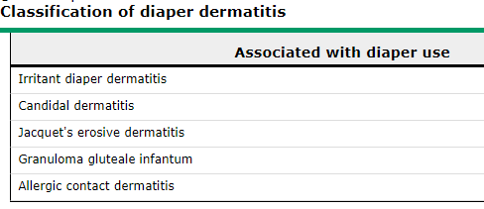
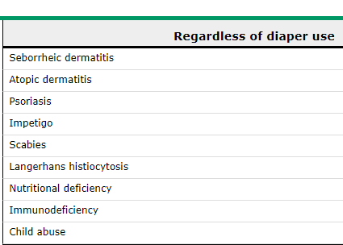

Slide 28
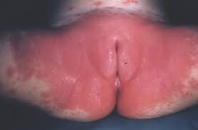
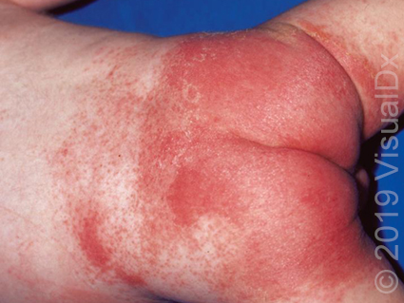

Slide 29
Aspects of the history that can help identify contributing factors and support or exclude nondiaper-associated dermatitis include:
Associated symptoms (eg, diarrhea).
Systemic symptoms (may suggest nondiaper-associated dermatitis, particularly LCH).
Information about diapers and diapering: type of diaper, how often diapers are changed, method of laundering cloth diapers (if cloth diapers are used).
Information about how the diaper area is cleansed (eg, soaps, cleansers, washcloths, wipes, etc).
Exposure to contagious disease (eg, scabies, herpes simplex virus, Staphylococcus aureus, group A Streptococcus).
Past history of dermatologic, allergic, or infectious illnesses.
Family history (eg, psoriasis, atopy).
Antibiotic use (predisposes to candidal dermatitis and diarrhea).

Slide 30
Ixn- usually are not necessary. help confirm the etiology in atypical or recalcitrant cases:
Potassium hydroxide preparation and/or fungal culture of skin scrapings for Candida
Mineral Oil slide preparation for scabies
Tzanck smear of blisters or pustules; multinucleated giant cells indicate a viral infection such as herpes simplex
Serum zinc level for acrodermatitis enteropathica
Culture of skin lesions for S. aureus or group A streptococcus
Skin biopsy in cases in which the rash is atypical or unresponsive to therapy (for LCH, granuloma gluteale infantum)

Slide 31
Management — eliminate direct skin contact with urine and feces (ie, by discontinuing
or limiting the use of diapers)
- Topical Barrier (Petroleum Jelly, Zn oxide cream, Paraffin)
- Powders
- Antifungal agents — nystatin, cotrimazole, miconazole, ketoconazole are effective topical therapies for candidal diaper dermatitis. Antifungal agents are indicated when:
The dermatitis appears to be candidal (eg, beefy red plaques, satellite papules, superficial pustules; involvement of the skin folds)
Is confirmed to be candida by potassium hydroxide preparation or fungal culture
The dermatitis has been present for at least three days (which increases the likelihood of secondary superinfection with candida).
-Antibiotics — If a secondary bacterial infection is present

